Slide 1

Machine Learning
Lee Sutton
Jordan Lui
December 6, 2016
SFU SciProg Group

Slide 2
Topics
What is Machine Learning?
Types of Machine Learning
Considerations
Overfitting
Regularizing

Slide 3
Mission
In this workshop we will give you a quick demo into Machine Learning using Python
Get your feet wet with a Machine Learning model
Understand some of the math intuition
Understand the different types of ML models, and know which tools to use
We’ll show you some of the great online resources to learn more

Slide 4
What is Machine Learning
Algorithms that improve performance through experience, or as we supply more data
Sometimes we have to guess and set a model for the data, but we don’t know the parameters.
ML will help us to learn the parameters to fit the model to our data
Applications: Robotics, medical imaging, computer vision, weather prediction, stock market, natural language processing,

Slide 5
What is Machine Learning
Some Terminology
Input (x). This is the input data we feed into a ML model
Target (t). These represent the “answers” to training
Weights or parameters (w)
Types of Data
Training data: To teach a ML model we feed it training data. This training data can have target data so that we can assess how well we trained the model
Testing Data: The best way to test a model’s true ability is to test it with data that it has not seen before
When we train and test a model, we use segment the data and “hide it” from the model

Slide 6
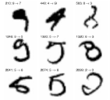
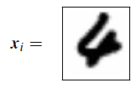
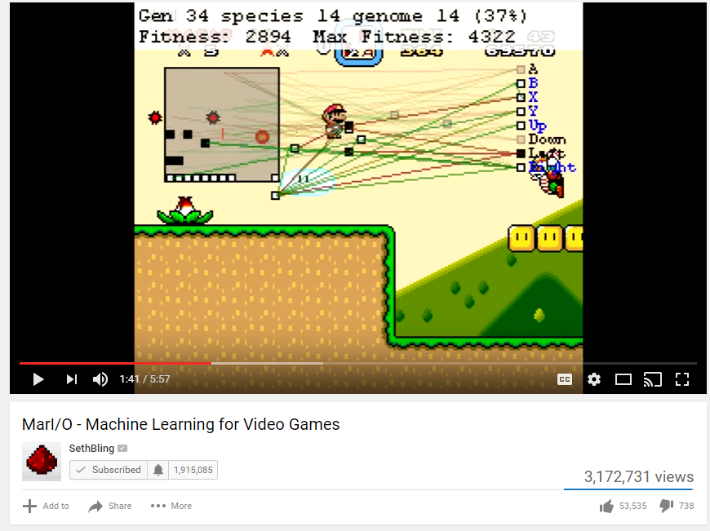
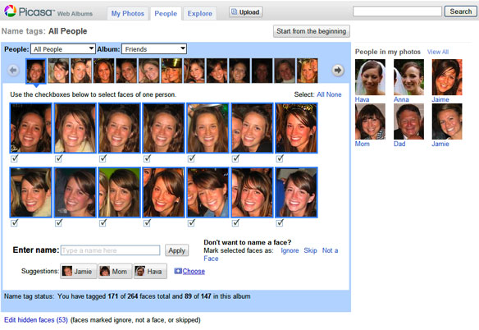
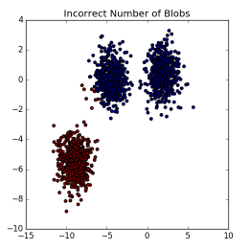
Types of Machine Learning
Supervised Learning
Unsupervised Learning
Reinforcement Learning

Slide 7
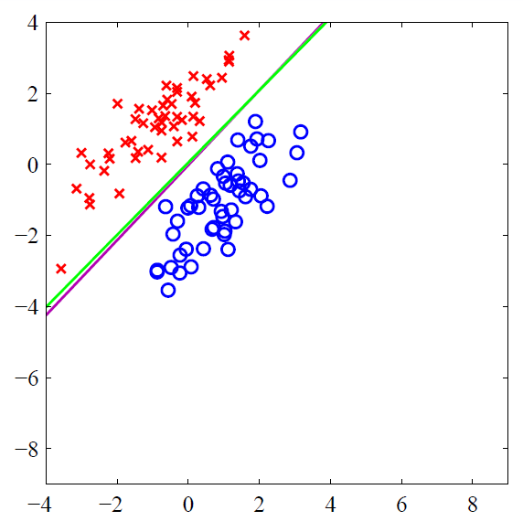
Types of Machine Learning: Supervised
We have training data which includes the target data (answers)
Regression
Problems where the target data is considered continuous
Modeling population growth or stock prices over time
Classification
The target data is discrete
Classifying a tumor biopsy as malignant or benign
Recognizing handwriting (optical character recognition)
Classifying images of cats and dogs

Slide 8
Types of Machine Learning: Unsupervised
If only the input data is provided, we are doing unsupervised learning
Segmenting data into groups based on variance
Clustering photos in Picasa
The model is looking for similarity in the inputs and grouping them

Slide 9

Types of Machine Learning: Reinforcement
Sometimes we don’t have target data to give the model… yet
The model does its best with the data, guesses, and we tell it whether it is right or wrong
The model receives negative and positive feedback and evolves over time
Just like how children learn
Related area: Genetic Algorithms
Example: Someone built a model to play Super Mario
At first it just mashed keys
Over time it learned to play the game
https://www.youtube.com/watch?v=qv6UVOQ0F44

Slide 10
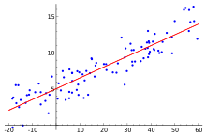
Regression
Like fitting a trendline through data points in Excel
We start with:
Some existing points
An estimate of the model structure (polynomial, sinusoid, other)
I.E. y = mx + b. More generally: y = w₀ + w₁x + w₂x² + w₃x³ + … w_{n}x^{n}
We let the ML model determine the optimal weight values to solve our system
The system above is easy to do in Excel with a linear trendline, but ML is required if we have additional dimensions or if the data is non linear

Slide 11
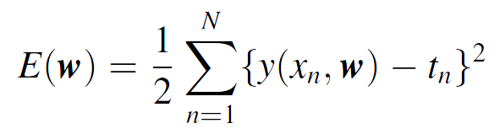
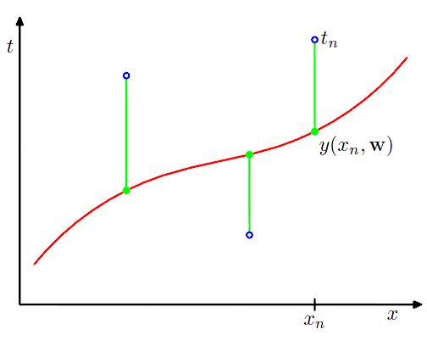
Linear Regression in Scikit-Learn
Linear regression in sci kit learn
Discuss minimization of Least squared error
How can we measure how well the model is doing?
One method – Sum of Squared Error

Slide 12
Polynomial Regression
Extend your linear model with basis functions
Replace x with phi(x)
Model is still linear with respect to the weights w

Slide 13
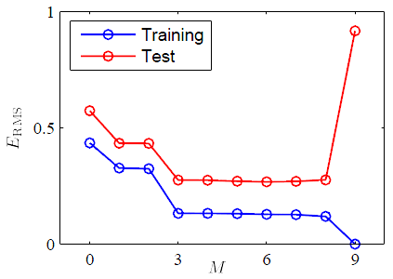
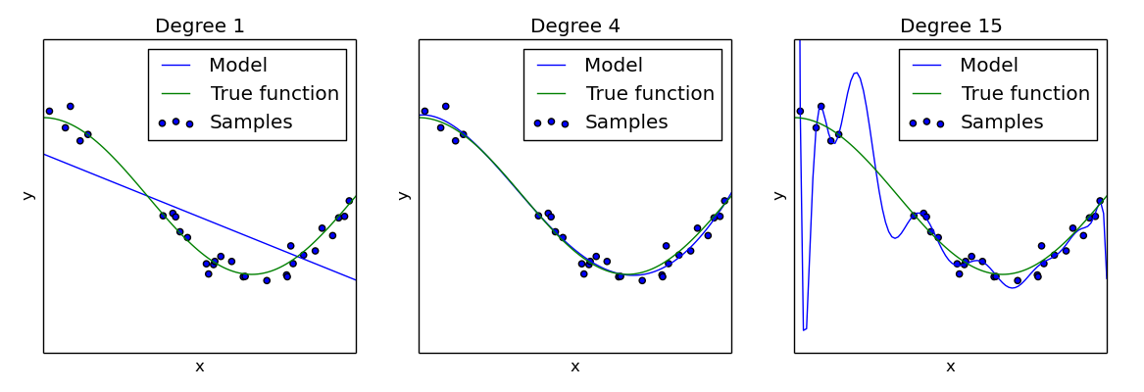
Regression: Overfitting
Why not use the highest order polynomial possible?
Our training error would continue to decrease
Overfitting!
However the model may perform poorly against its test data
The model would fail to generalize against new data

Slide 14
Multivariate regression
Both of us look at this

Slide 15
Conclusion
We have talked about the various types of Machine Learning problems at a high level
There are several resources for more learning on the topic
http://sciprog.ca/
http://scikit-learn.org/stable/
https://www2.cs.sfu.ca/~mori/courses/cmpt726/
https://portal.cs.sfu.ca/portal/outlines/1171-CMPT-733-G100/

